Slide 1
Session 1.1:
Welcome and Introduction

Slide 2
Survey data and indirect estimation
Why this type of course?
Course objectives
Course dynamics and expectations

Slide 3
Three challenges in statistics (Gelman et al., 2024):
Generalise from a sample to the population: survey data and sampling
Generalise from a series of indicators to a construct of interest: measurement
Generalise from a treatment group to the control group: causal analysis

Slide 4
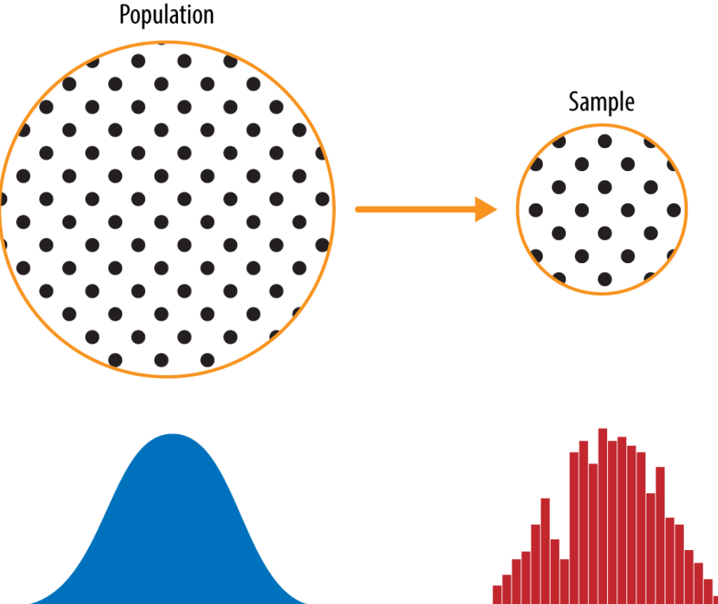
Why this type of course?
Key challenge in statistics:
Generalise from the sample to the whole population

Slide 5
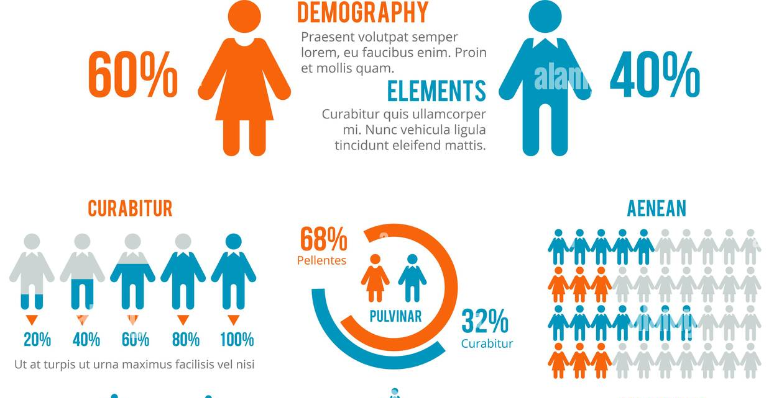
Why this type of course?
Two advantages of survey data:
Cost-effective: No need to collect data from the full population
Specific inference: Increase thematic coverage of the questionnaire

Slide 6
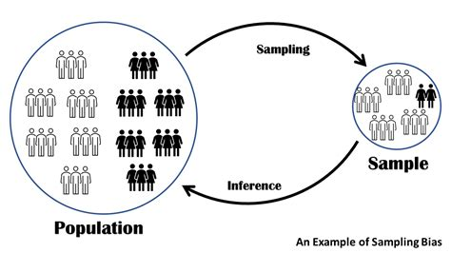
Why this type of course?
Survey data limitations:
Sometimes the sample is not enough (Can’t generalise with confidence)
Sometimes the sample is wrong

Slide 7
Why this type of course?
Survey error:
It’s inevitable (sampling, collection, response, coding, etc.)
It’s unwanted random and systematic variability
But… it’s measurable and, sometimes, amendable
True % children
Unreliable and biased survey estimate
Ideal survey estimate
Unreliable survey estimate

Slide 8
Why this type of course?
It would be great to have some workflow and methods to solve this problems:
Know the reliability
Correct the reliability
True % children
Unreliable survey estimate
Reliable survey estimate

Slide 9
Why this type of course?
It would be great to have some workflow and methods to solve this problems:
Know the bias
Correct the bias
True % children
Unreliable and biased survey estimate
Reliable and unbiased survey estimate

Slide 10
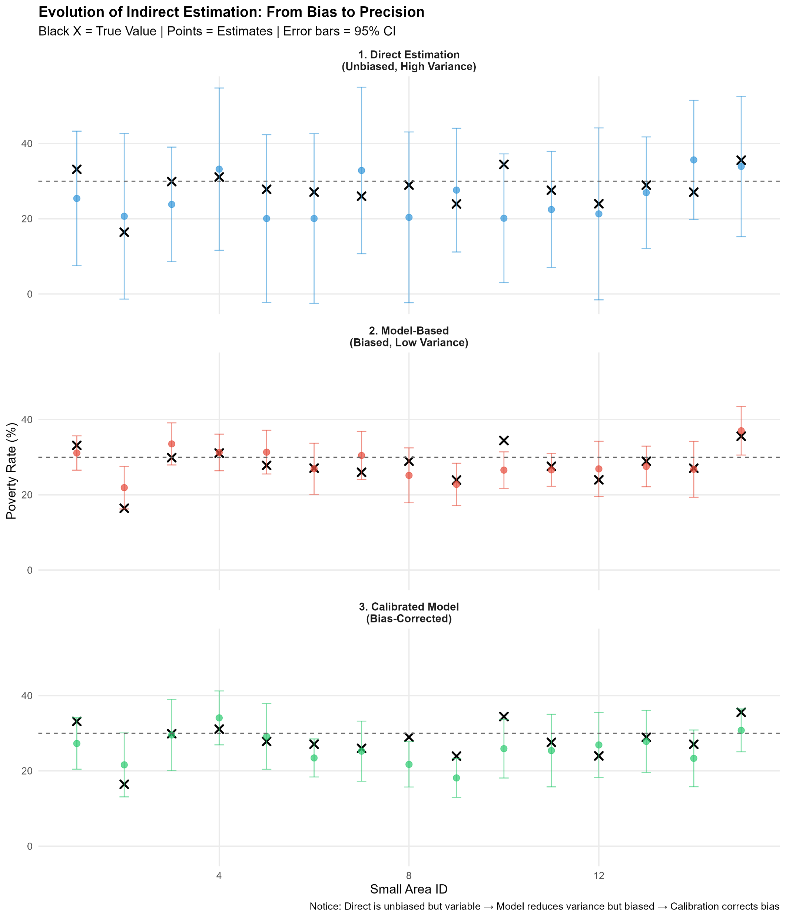
Why this type of course?

Slide 11
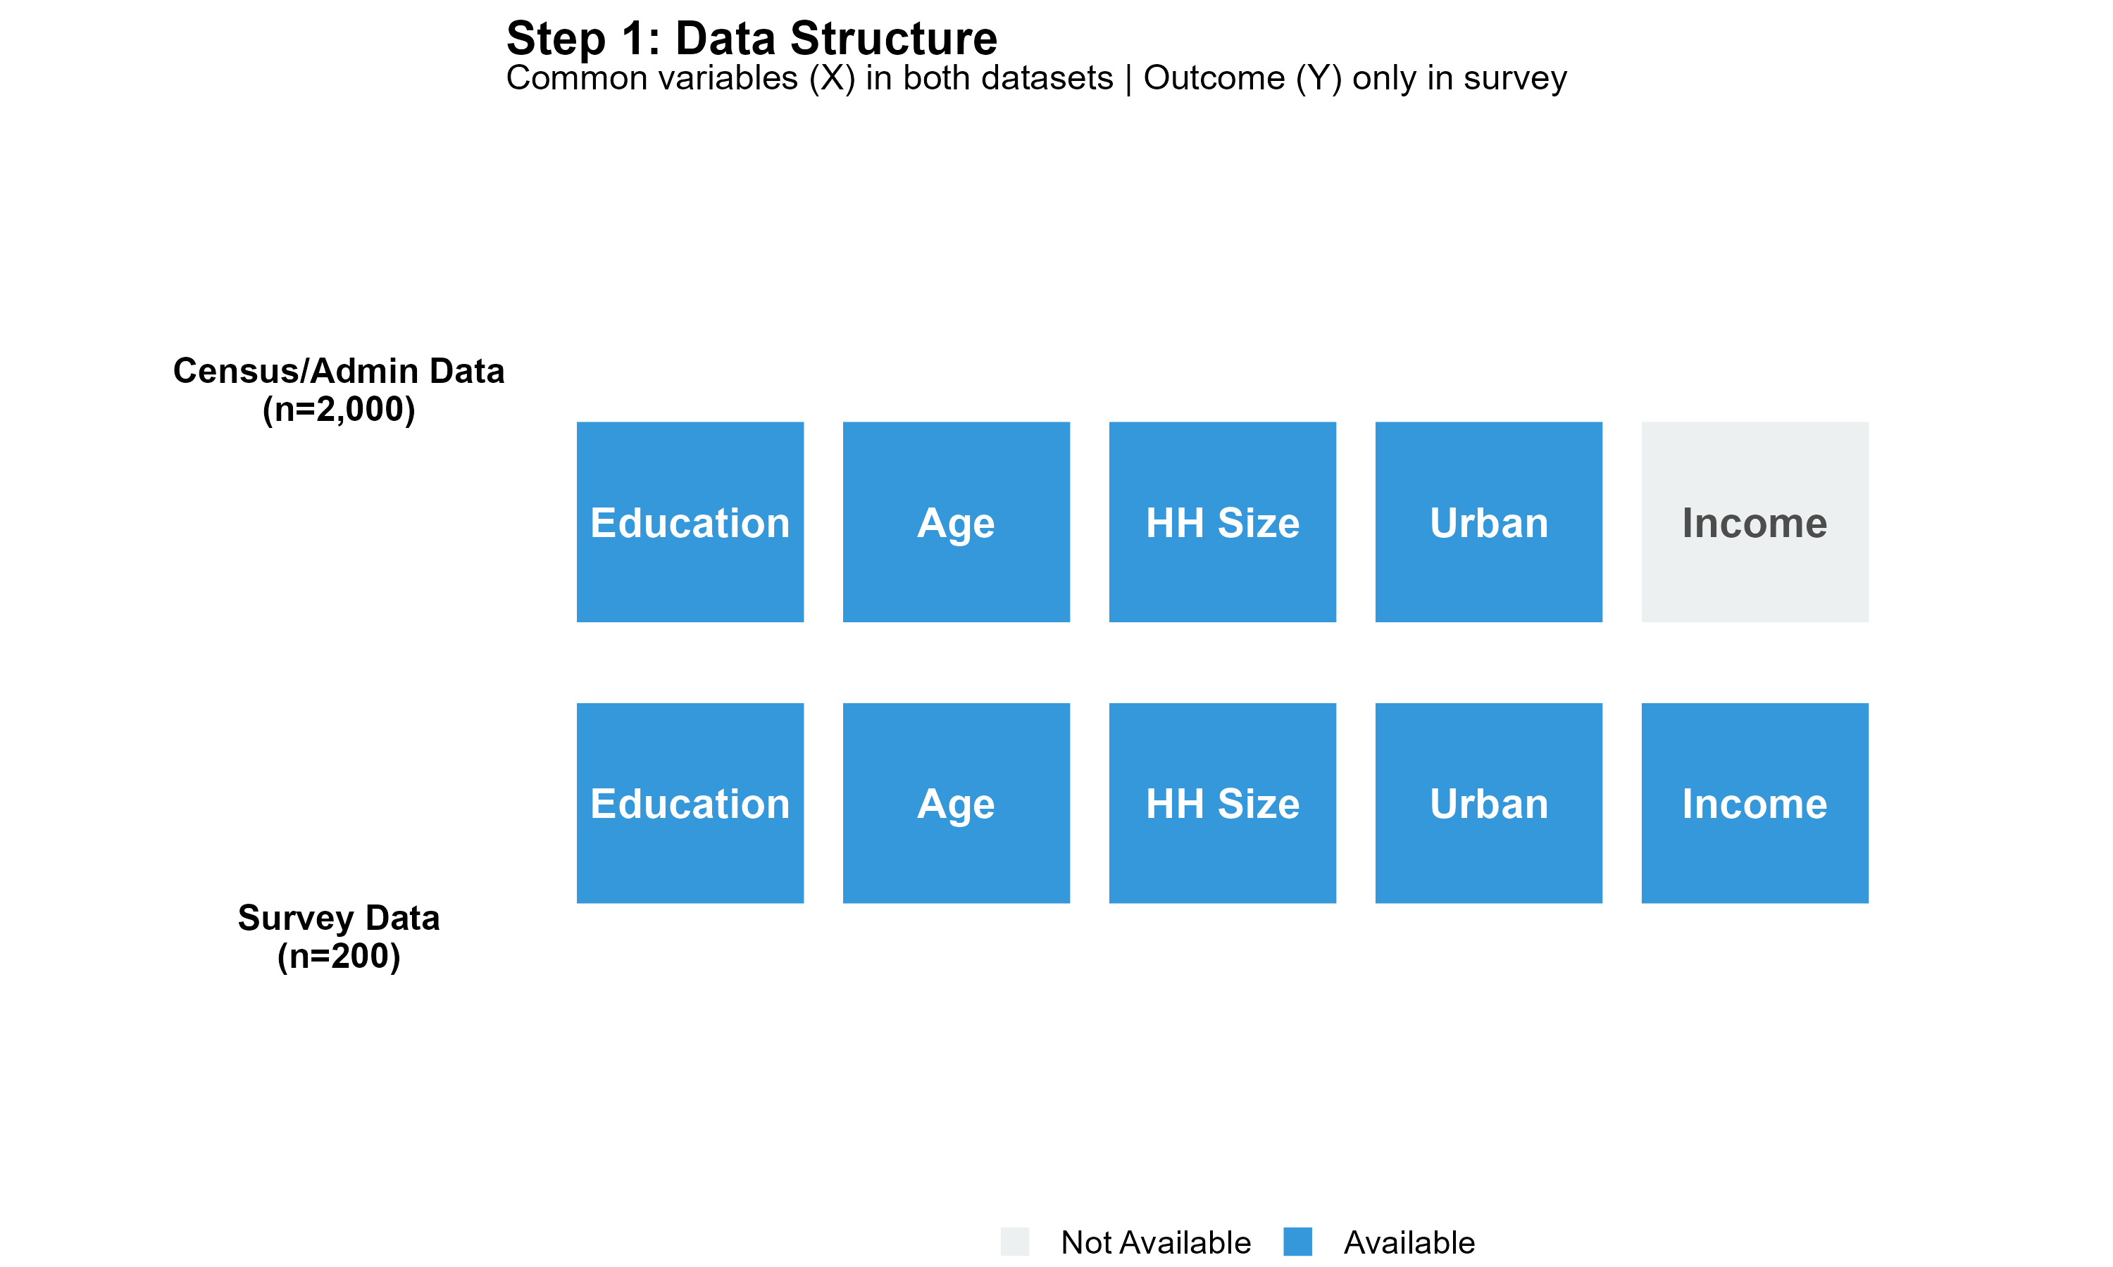
Why this type of course?

Slide 12
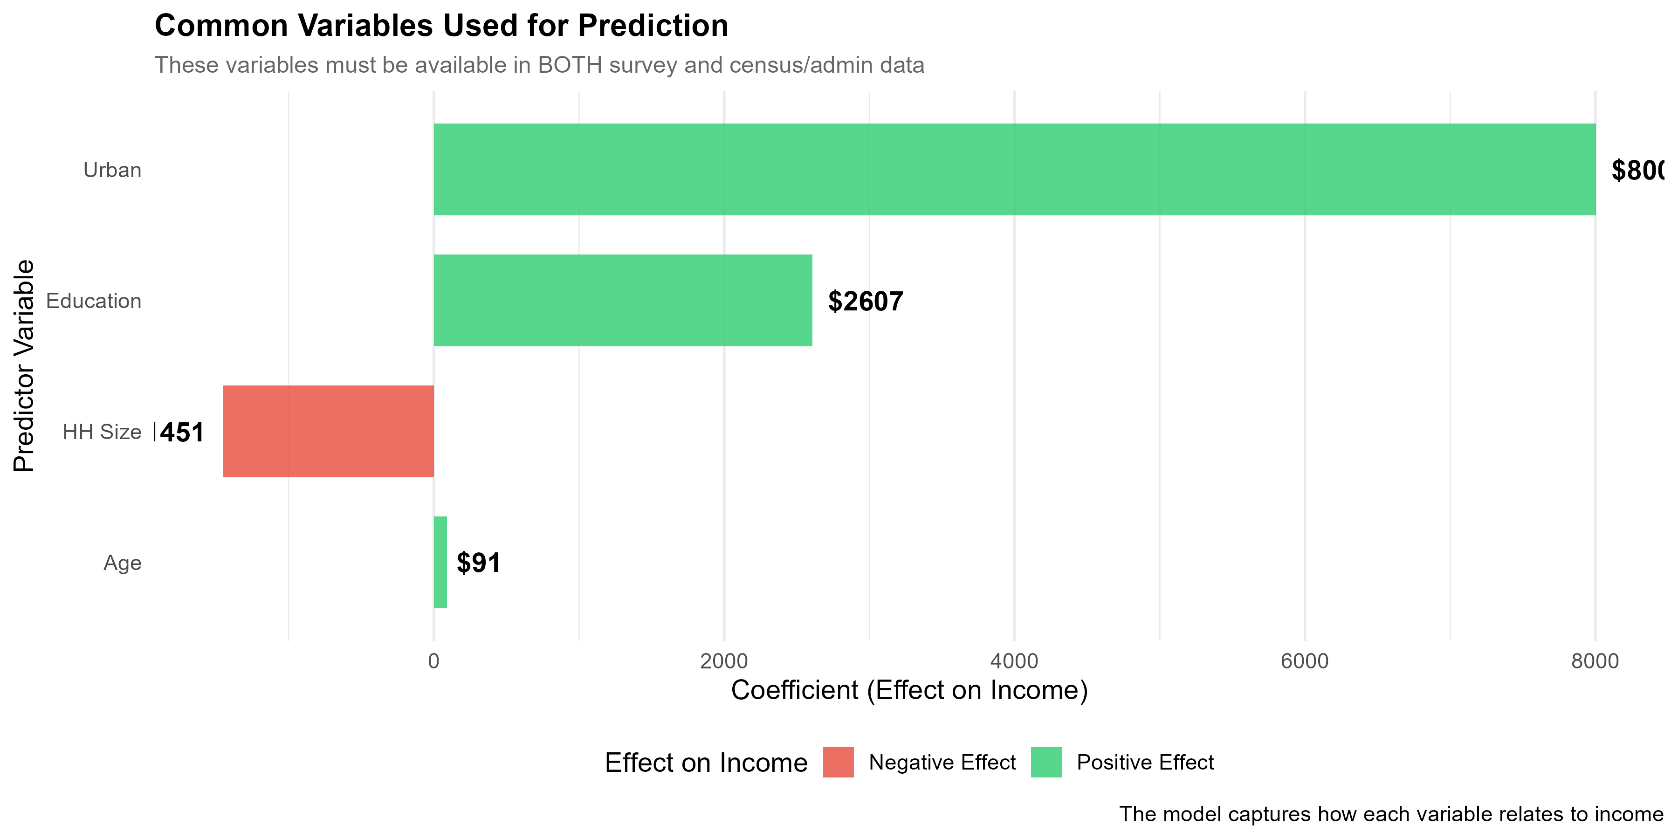

Slide 13
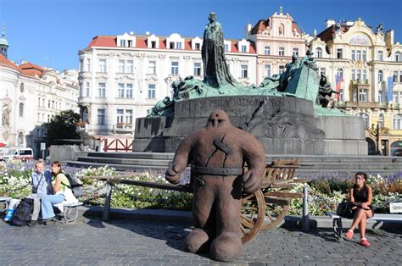
Models
Not inherently good or bad
They just follow instructions
We don’t want to destroy a city using them wrongly

Slide 14
Objectives
1. Producing basic descriptive analyses using survey data and embrace uncertainty in statistics
2. Understanding the basic principles involved in direct and indirect estimation
3. Understanding the role that predictive models have to produce in-sample and out-of-sample statistics
4. Mapping variables of interest

Slide 15
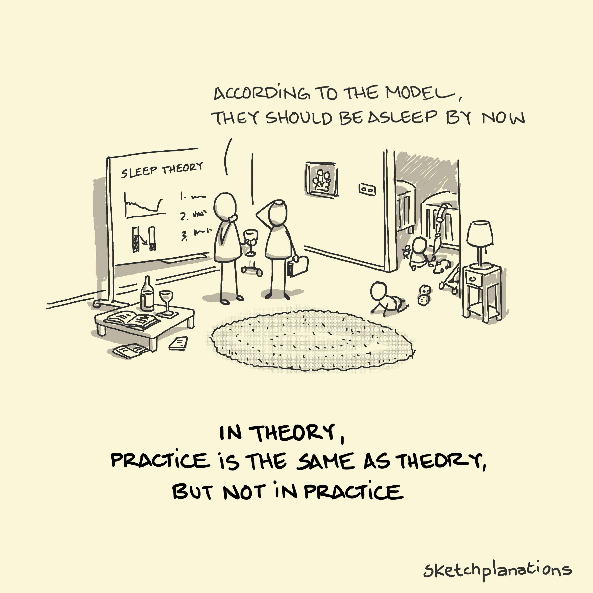
Course dynamics and expectations
Theory/concepts
  Why and what
Practice
  How

Slide 16
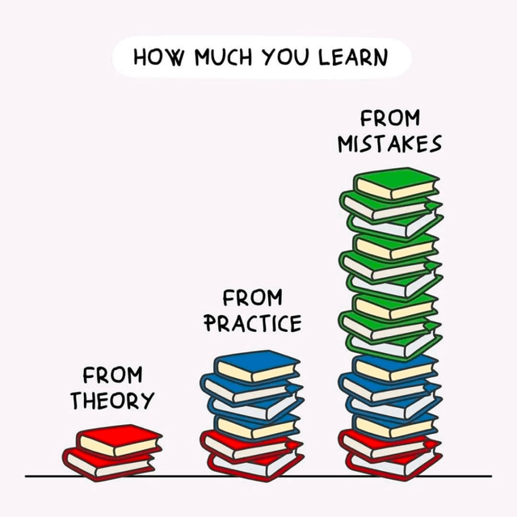
But…

Slide 17
Do you remember R-software?
Yes, something about R and Rstudio
Yes, I remember that it was about working with objects
Yes, I remember that learning a bit of code is useful for reproducible research
Yes, I remember we use Rmarkdown to generate pretty documents
Yes, I remember to compute basic descriptives
Yes, I still
No, not really.

Slide 18
Materials:
https://github.com/hectornajera83/KNSOSurveyData2025/

